Slide 1
WOW V
Personal Finance
Money Management

Slide 2
Checking Account
A financial account, usually with a bank, that allows the customer to pay for goods and services by using a debit card or writing a check.

Slide 3
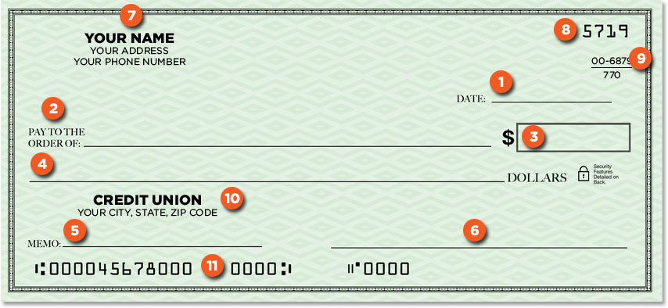
Parts of a Check
Todays Date
Payee
Amount in Numbers
Amount in Words
Memo Note Line
Signature Line
Accountholder Info
Check Number
Bank ID Number
Bank Info

Slide 4
Writing a Check
When writing a check, you should use this order:
WHY??
Todays Date
Payee
Amount in Numbers
Amount in Words
Memo
Fill in Checkbook Register
Signature

Slide 5
Writing a Check
Todays Date
Check must be dated on Current Date-Post Dating is illegal.
Payee
NEVER Leave this line blank, ANYONE can cash a blank check.
Amount in Numbers
NEVER Leave this blank, the Payee can enter any number they want, and rip you off.

Slide 6
Writing a Check
Amount in Words
Never leave this blank.
Used to verify the Amount in Numbers
Don’t Abbreviate anything.
Memo
Not neccesary, but helpful.
Sometimes it is required for payments like Utility Accounts or Medical Payments where the Payee needs YOUR account number.

Slide 7
Writing a Check
Fill in Checkbook Register
Why now?
So that you Don’t Forget
To ensure you have sufficient funds.
To verify your ending balance.
Signature – Why Last??
Must sign for check to be Valid
Save for last to ensure you finish all steps.

Slide 8
Savings Account
A financial account, usually with a bank, that provides principal security and a moderate interest rate; funds are slightly less accessible than funds in a checking account.

Slide 9
Endorsing a Check
Signing the back of a check, releasing it to a bank for deposit or to be cashed. ** Can also be done to release a check to a second party, giving them ownership. Be Careful!!

Slide 10
Bank Statement
A report from a bank which lists the monthly starting balance, ending balance, and all transactions processed, including interest, fees, and penalties.

Slide 11
Reconciliation
The process used by the account holder to ensure that he/she and the bank agree upon all transactions within the particular account.
- It should be done monthly.

